Slide 1
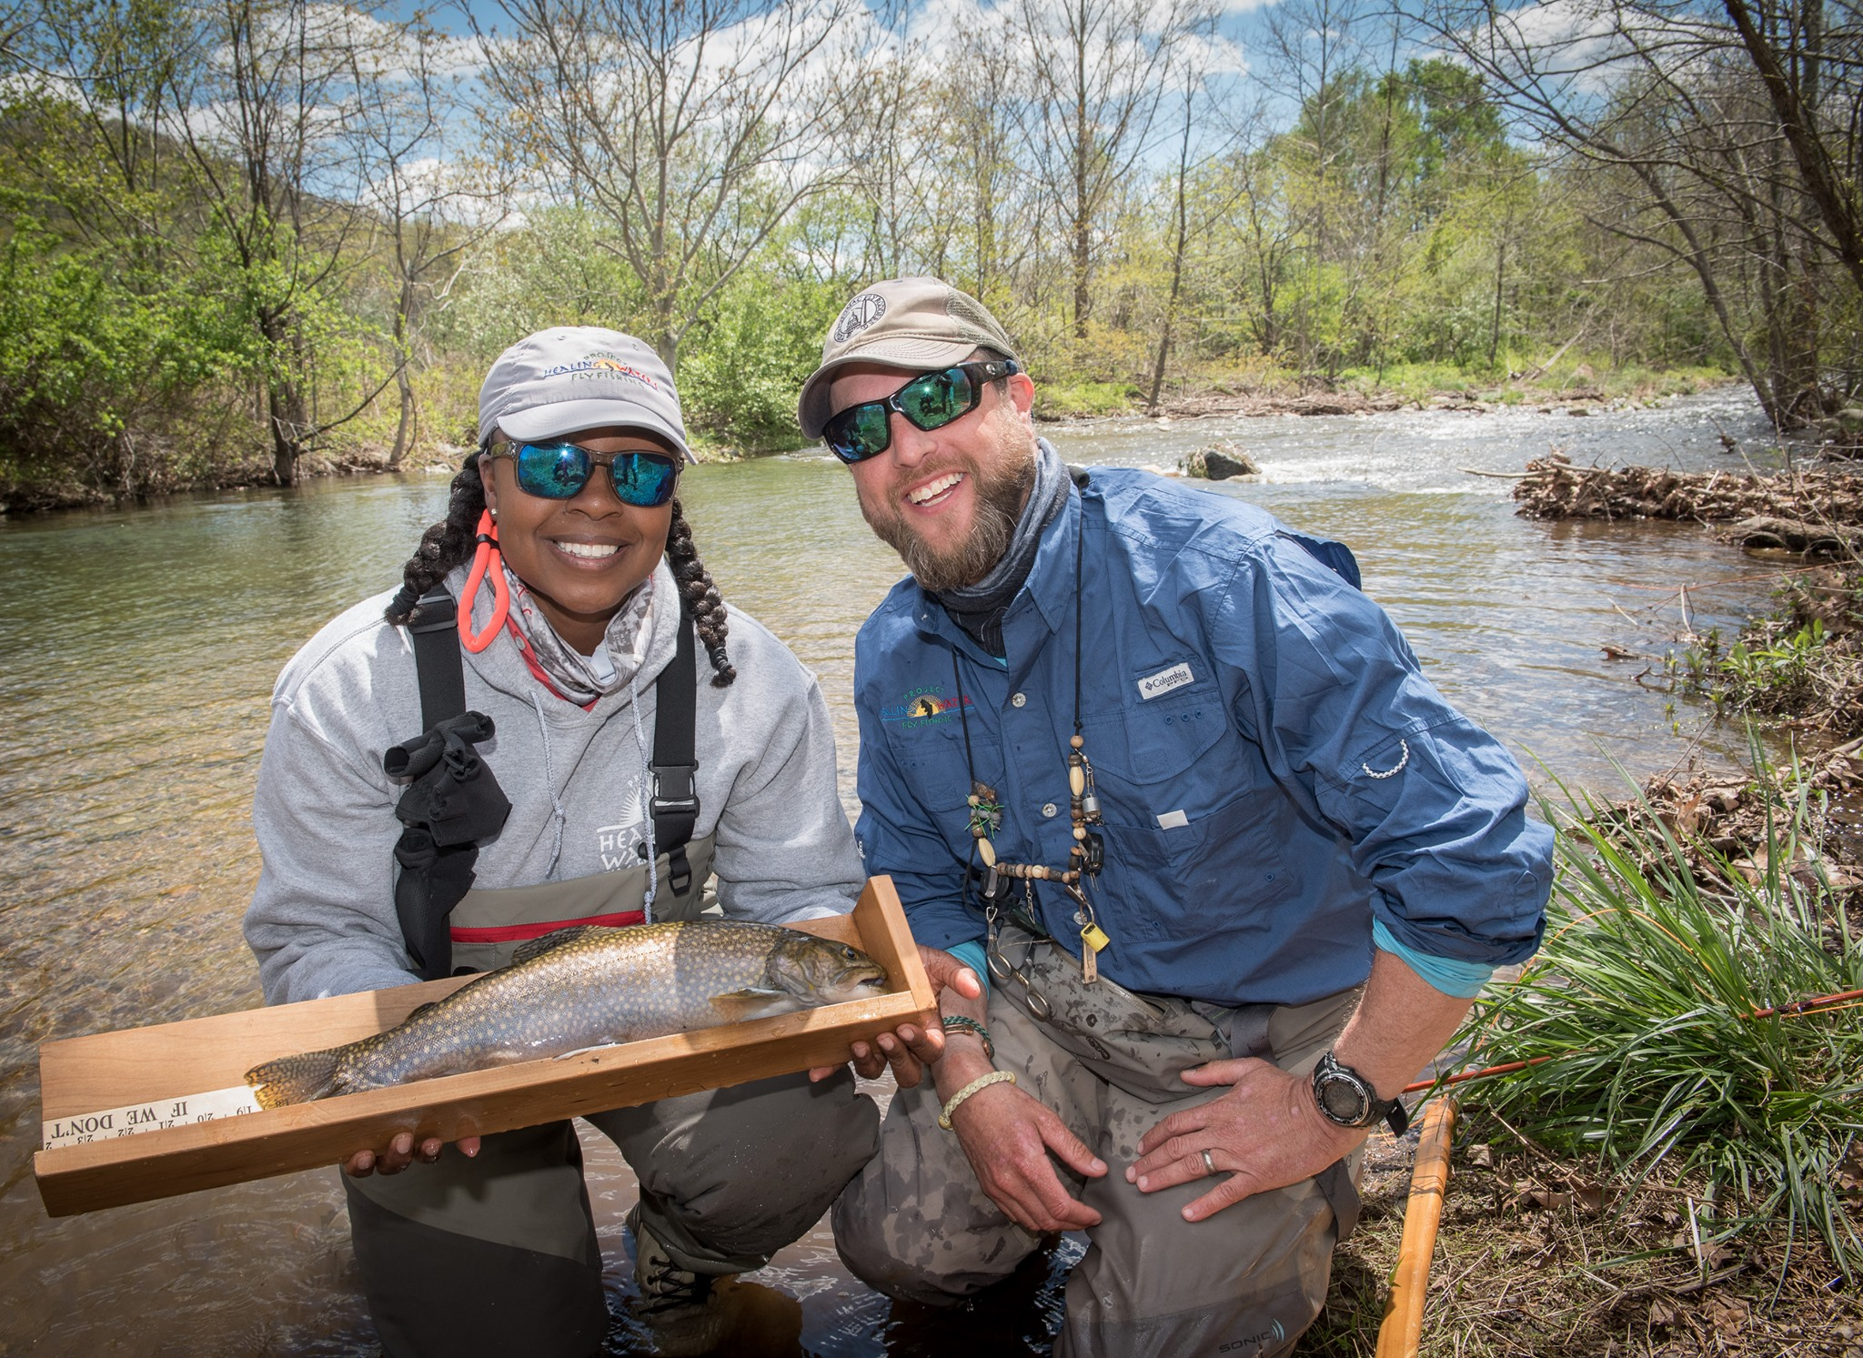
Project Healing Waters can teach you!
We are a national non-profit with programs throughout the U.S.
We work with men and women with all types of disabilities. We teach regularly scheduled classes in fly fishing basics, fly casting, fly tying and rod building. We also offer fishing outings, both one-day and multi-day. Everything is provided to all participants at no cost.
If you are a disabled veteran or active duty you may be eligible.
Contact us below:
[NAME]
[EMAIL]
[PHONE NUMBER]

