Slide 1
www.projecthealingwaters.org

Slide 2
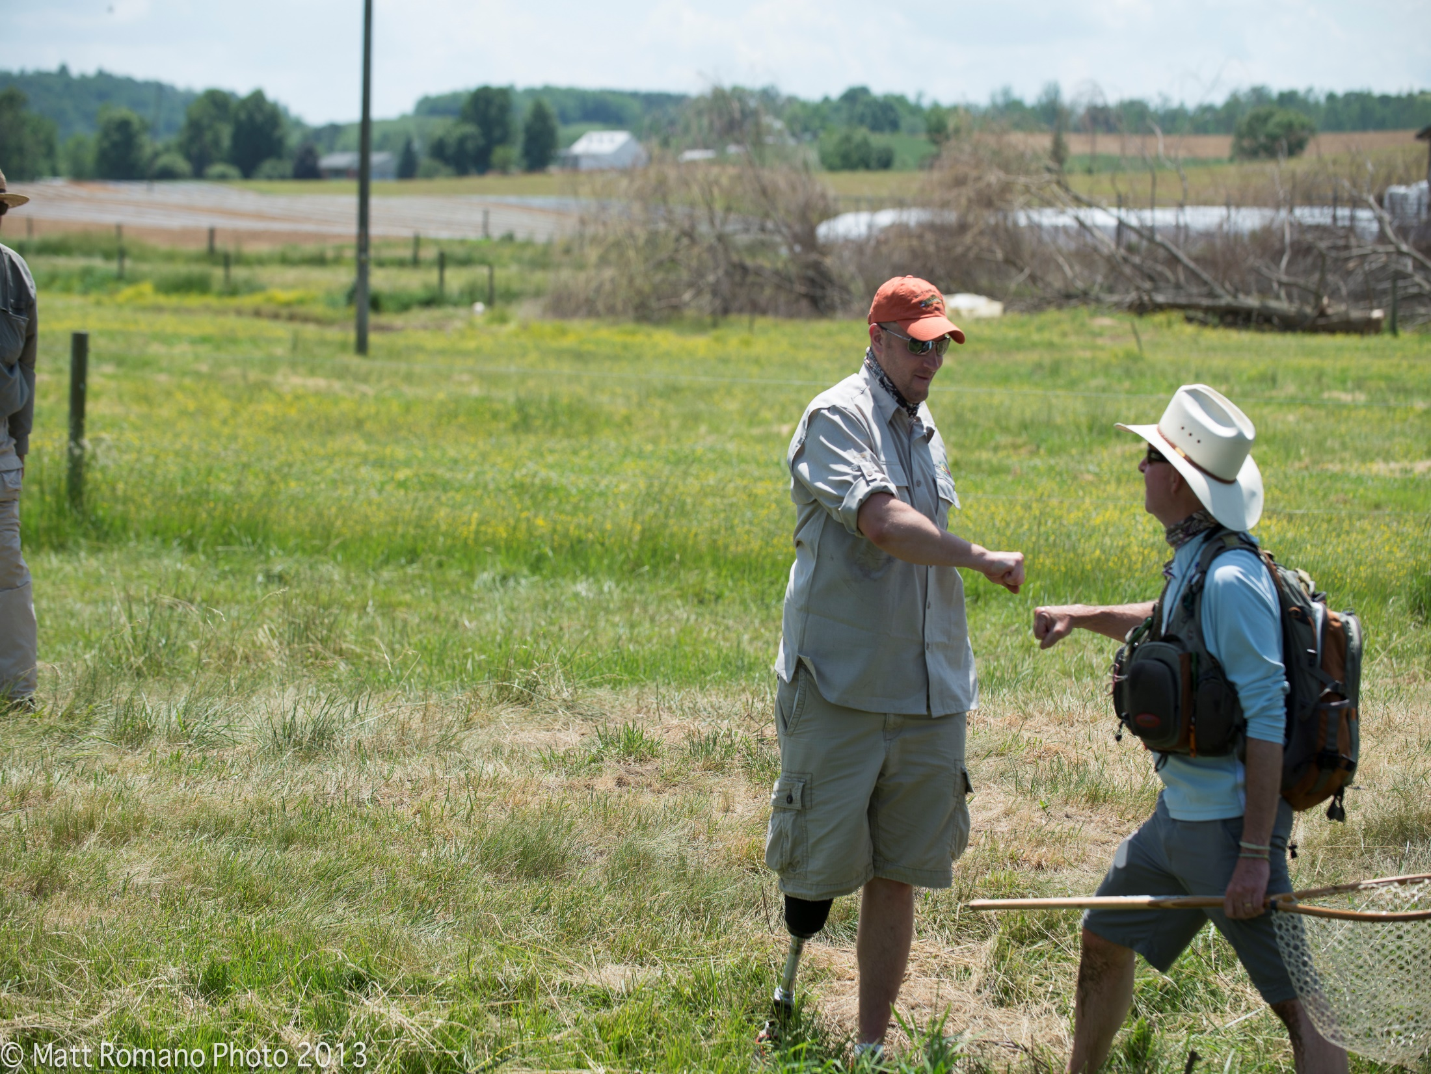
Mission
Dedicated to the physical and emotional rehabilitation of disabled active military service personnel and veterans through fly fishing, fly tying, education and outings.

Slide 3
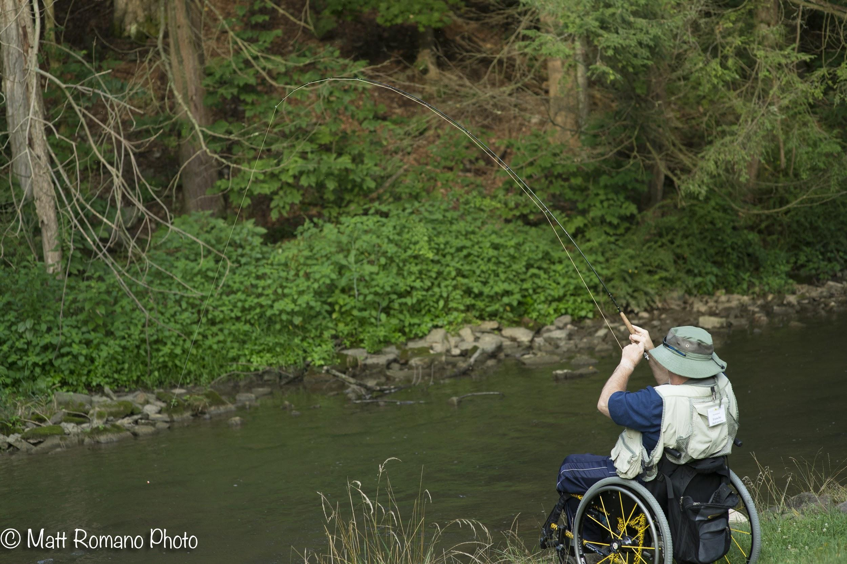
Program
.
A continuum of care
Fly Fishing education
Fly Tying
Fly Rod Building
Outings
Community

Slide 4
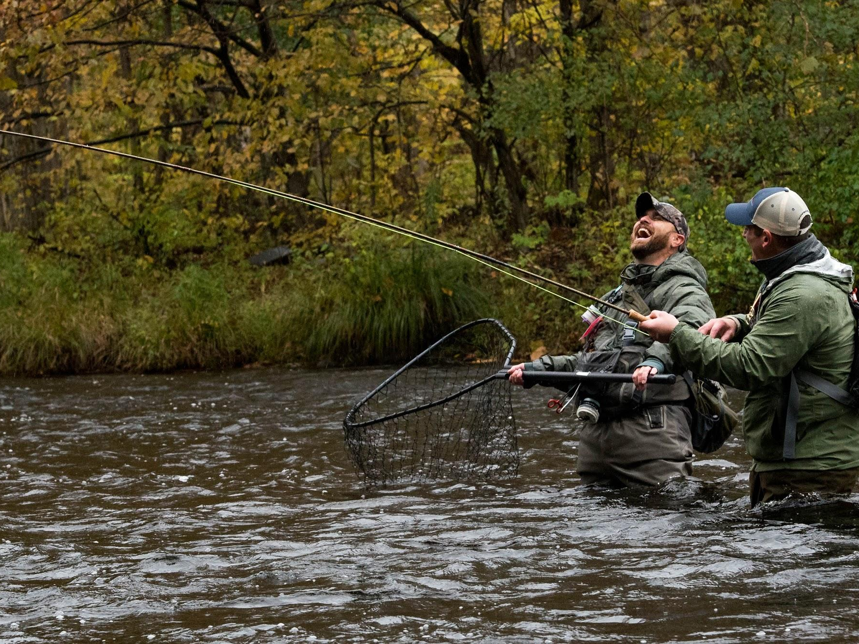
Partners
U.S. Department of Veteran Affairs
Fly Fishers International
Trout Unlimited
Independent Clubs
Fly Shops
Communities throughout the U.S.

Slide 5
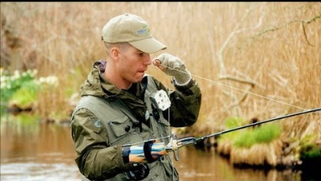

Slide 6
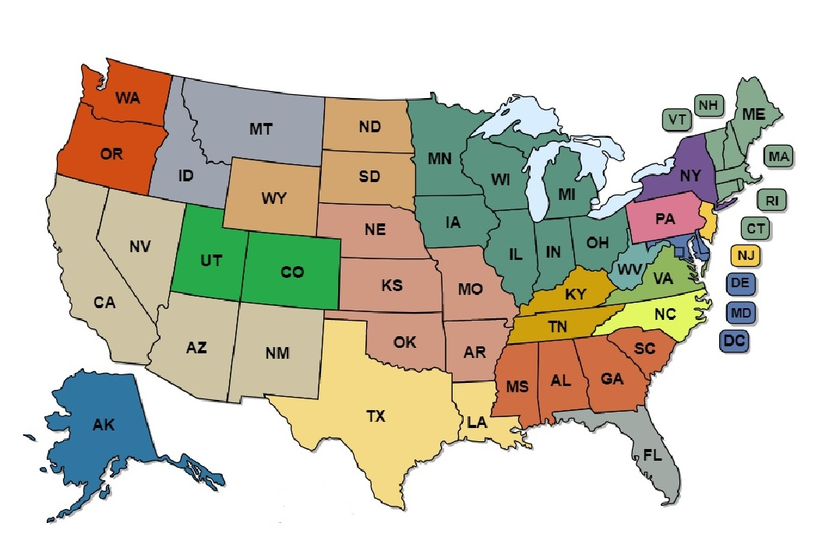
Locations
48 STATES 200+ PROGRAMS
Our volunteers are teaching classes on an on-going, long term basis.
It is much more than a one day fishing trip

Slide 8
[Insert local pictures]

Slide 9
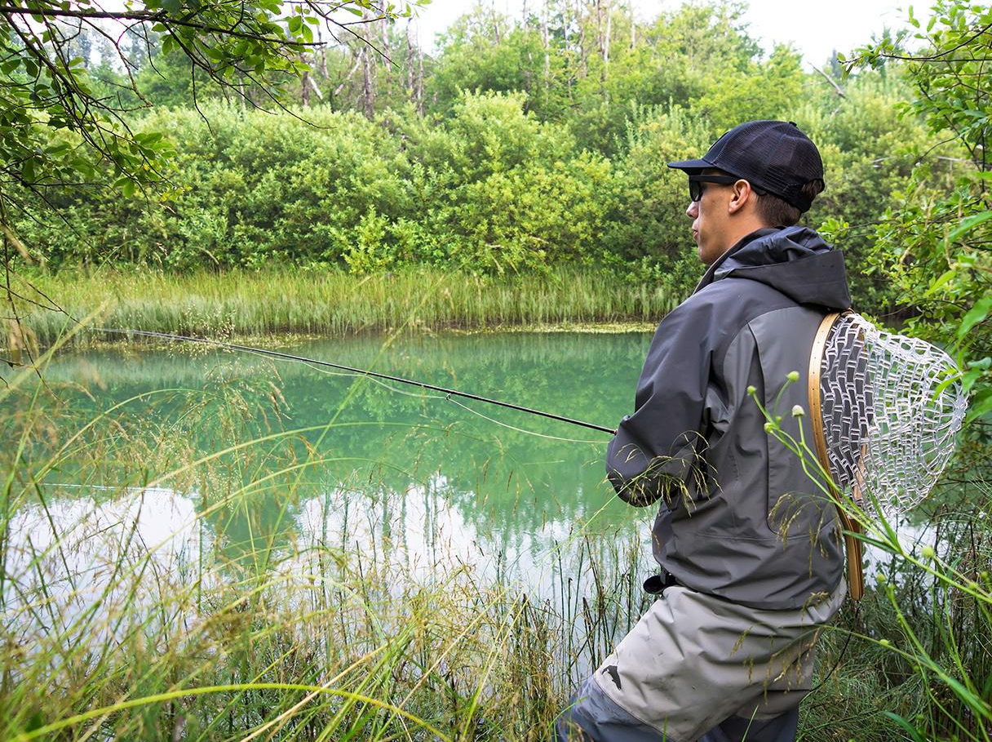
[program name]
[activities]
[location]
[meeting time(s)]
[contact info]
Our volunteers are teaching classes on an on-going, long term basis.
It is much more than a one day fishing trip.

Slide 10
[Insert local pictures]

Slide 11
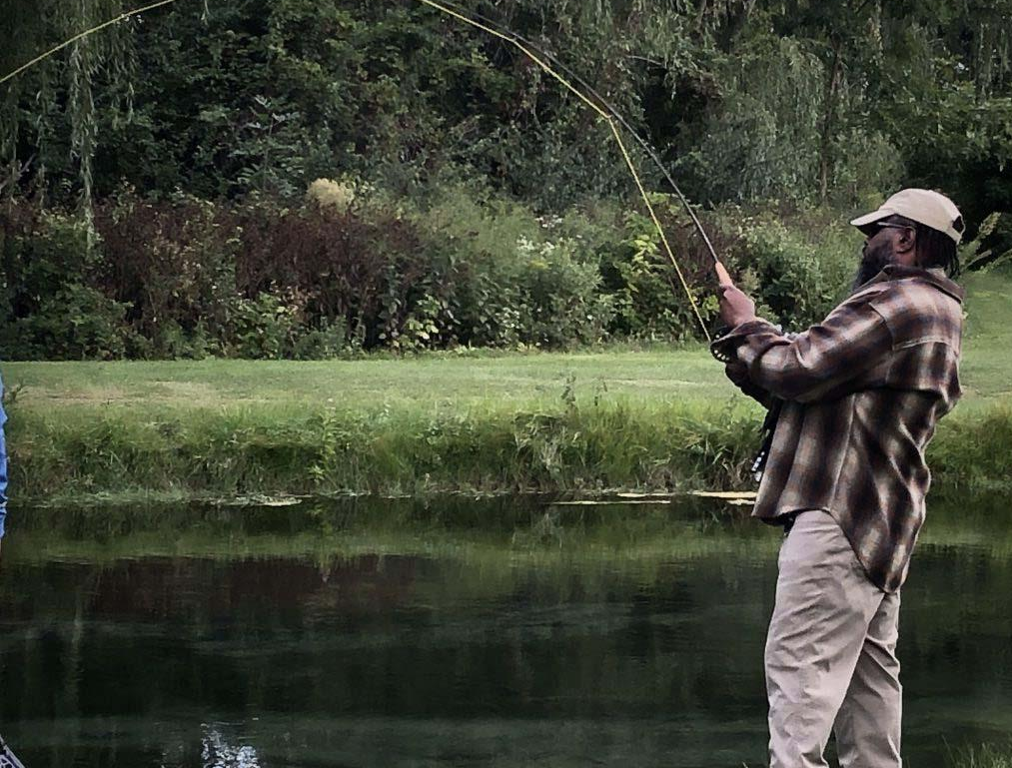
[program name]
[local information]
[local testimonial]
Healing Those Who Serve

Slide 12
[Insert local pictures]

Slide 13
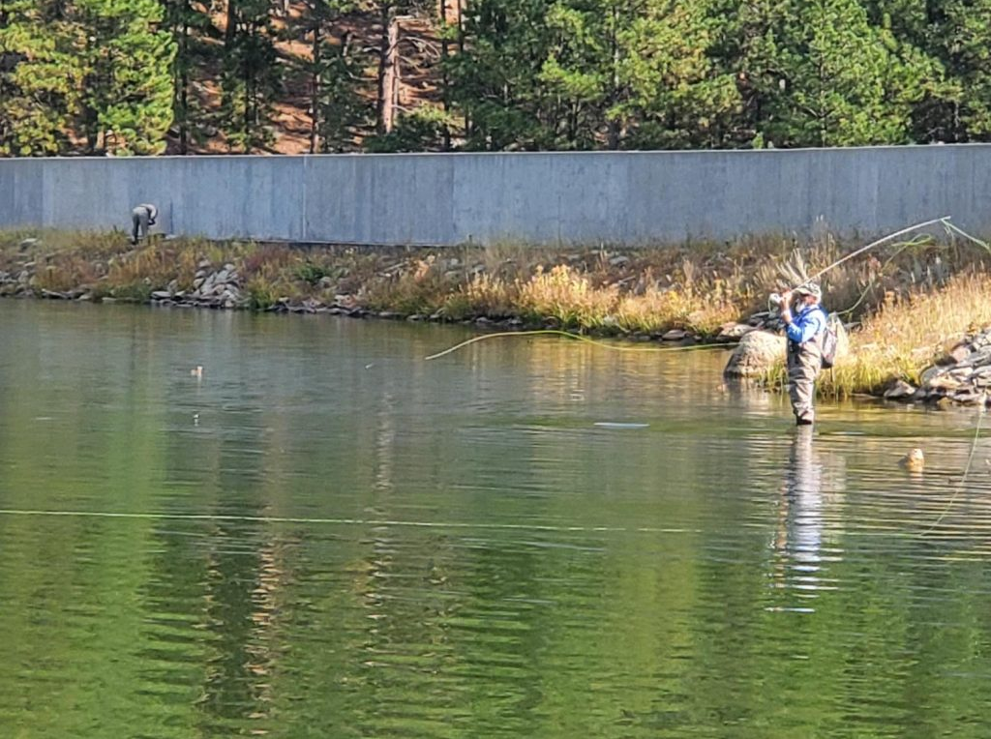
[program name]
[additional local information]
Healing Those Who Serve

Slide 14
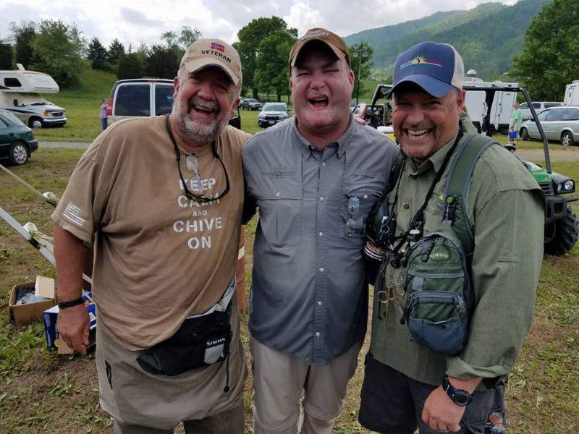
Our Work Continues

Slide 15
www.projecthealingwaters.org

Slide 16
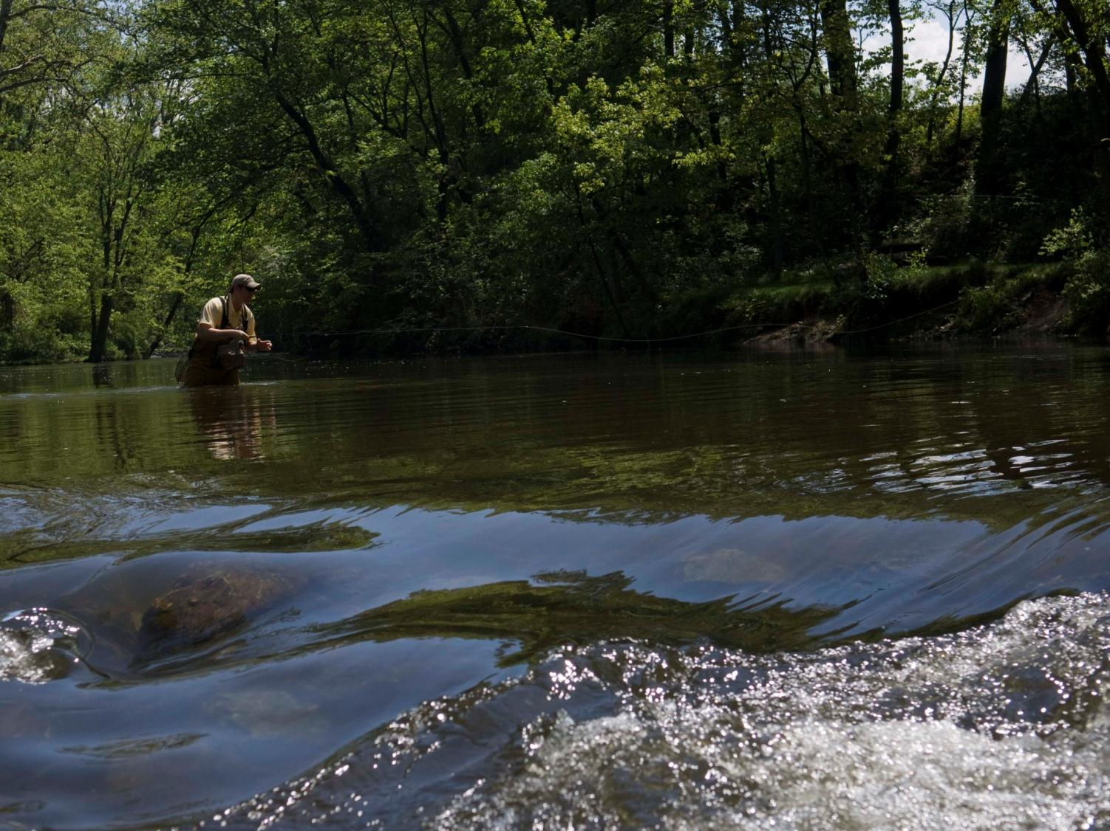
THANK YOU!
www.projecthealingwaters.org
[insert contact information]

